Slide 1
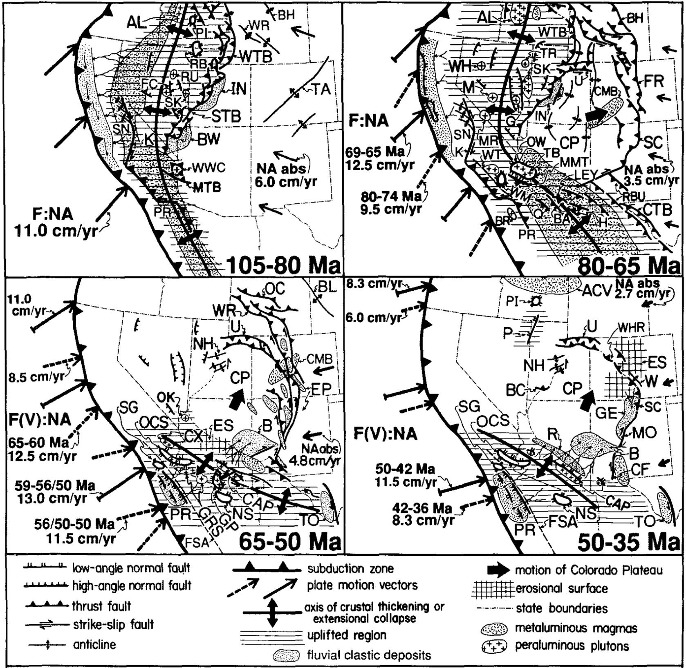
Role of crustal thickening and extensional collapse in the tectonic evolution of the Sevier-Laramide orogeny, western United States
Livaccari, 1991
Presented by Luke J. Schranz

Slide 2
Background
120-80 Ma (early) Sevier deformation characterized by foreland fold-thrust and magmatic arc
80-75 Ma, Laramide deformation propagated eastward
Laramide deformation ceased at 56 Ma in the northern Cordillera and 35 Ma in the southern and central Cordillera

Slide 3
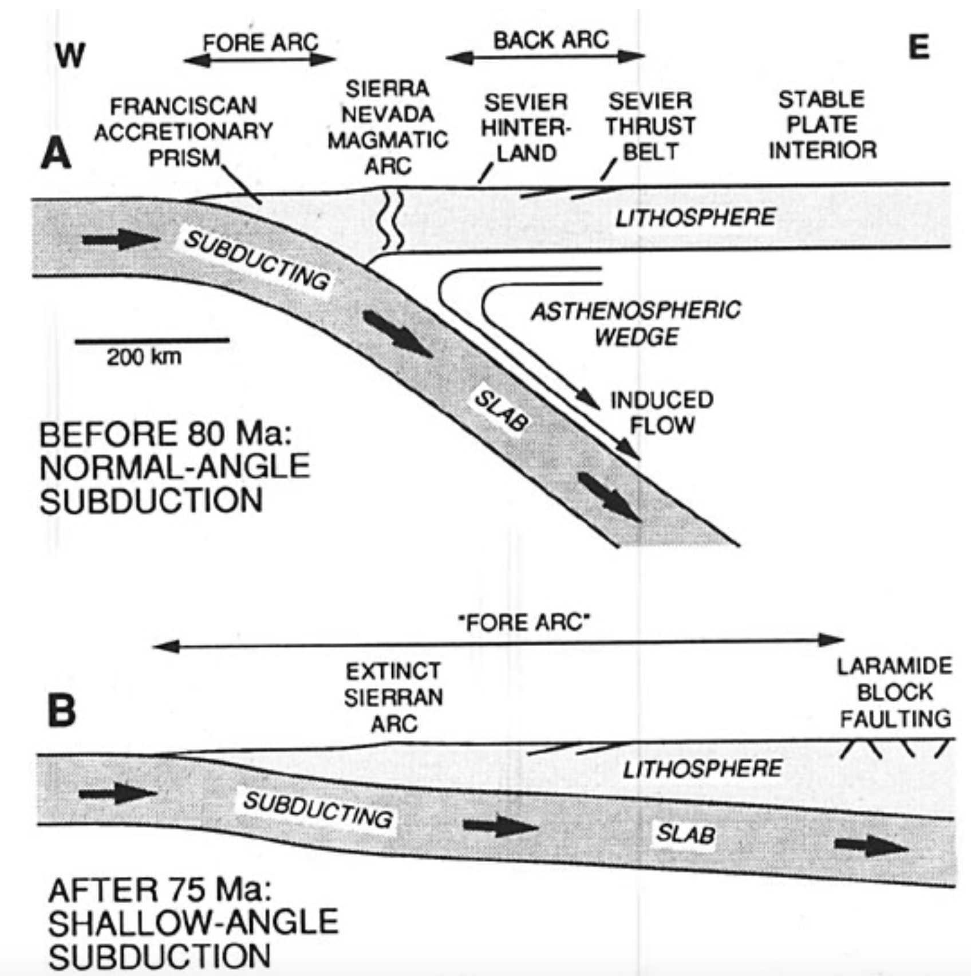
Dumitru et al.,1991

Slide 4
Crustal thickening and extensional collapse
Deep-seated heated by subduction decreases crustal strength
Uplifted region may grow laterally once max elevation is achieved causing adjacent lowland to thicken
Uplifted regions may guide stresses across flanks
Plateaus higher than 3km are subject to gravitational collapse
Extensional collapse may assist to drive forehand thrusting as long as the orogen remains topographically higher

Slide 5
Crustal thickening and extensional collapse
Sevier-Laramide orogeny —> Cenozoic extensional collapse
Extension during the orogeny may have equalled or exceeded Cenozoic extensional deformation

Slide 12
Discussion
Great Basin extensional collapse = 90-60 Ma
Southern cordillera extensional collapse = 75-35 Ma
Tertiary extensional collapse of the southern Cordillera drove CP to the NNE —> late phase of Laramide foreland deformation

